Slide 1
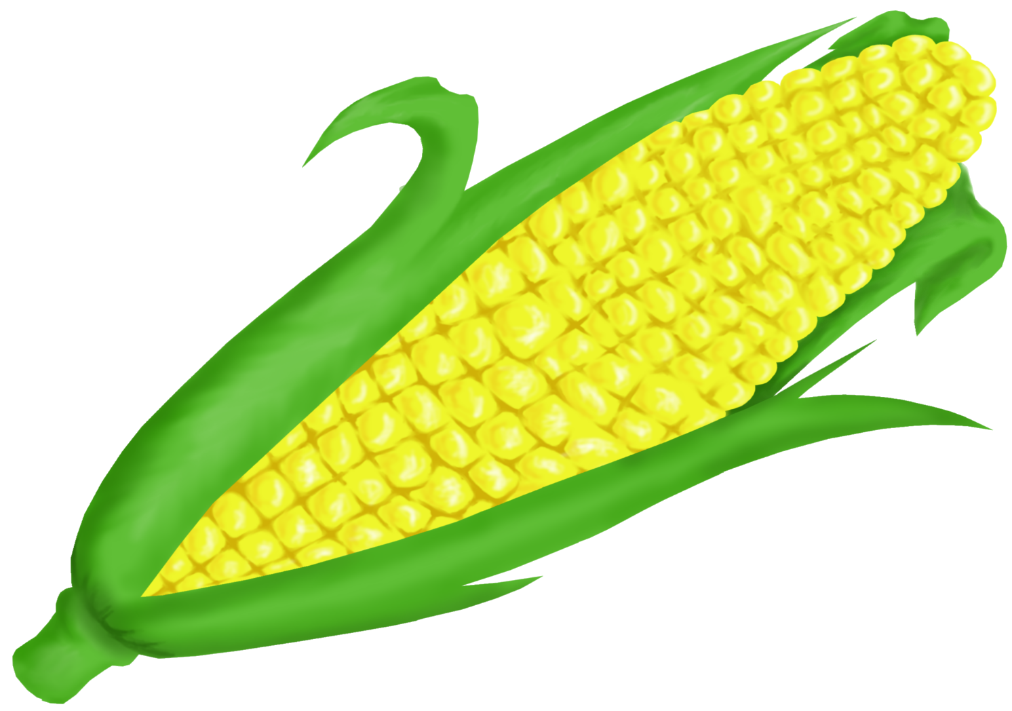
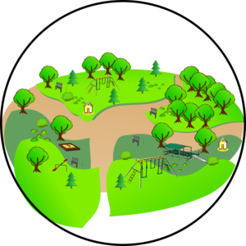
The Five Parts of a Habitat
Air
Water
Shelter
Food
Space

