Slide 1
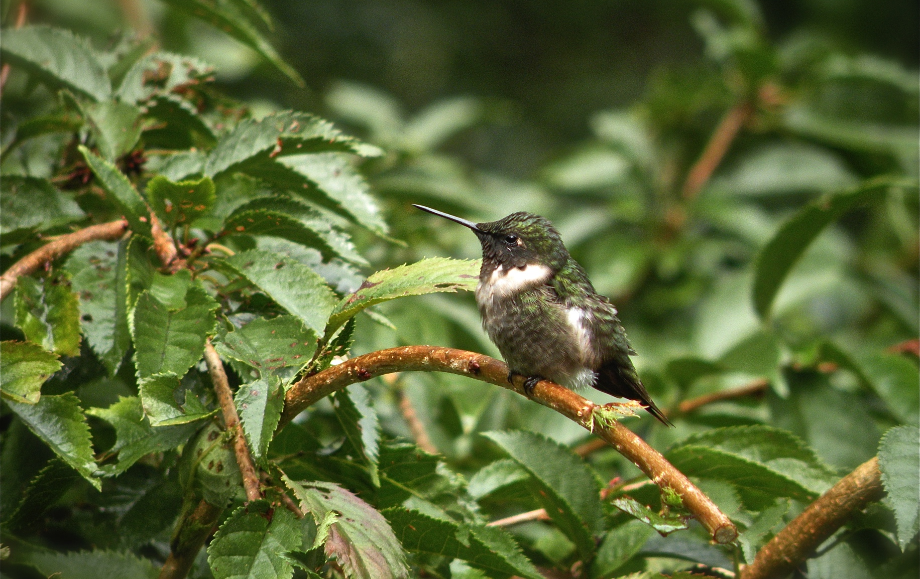
Hummingbird

Slide 2
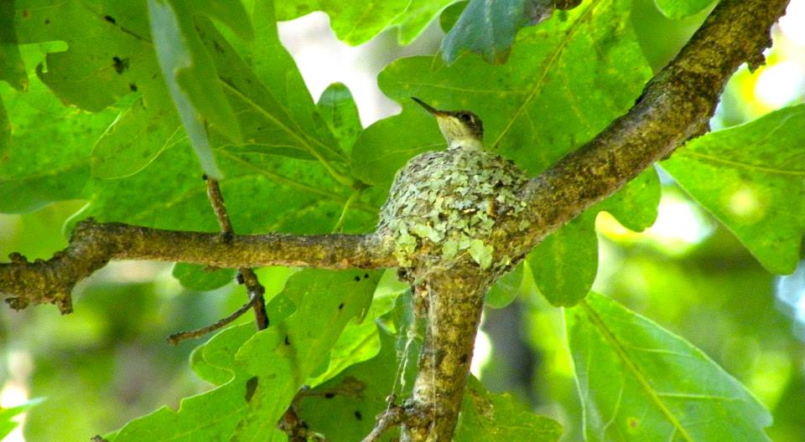
Hummingbird Nest

Slide 3
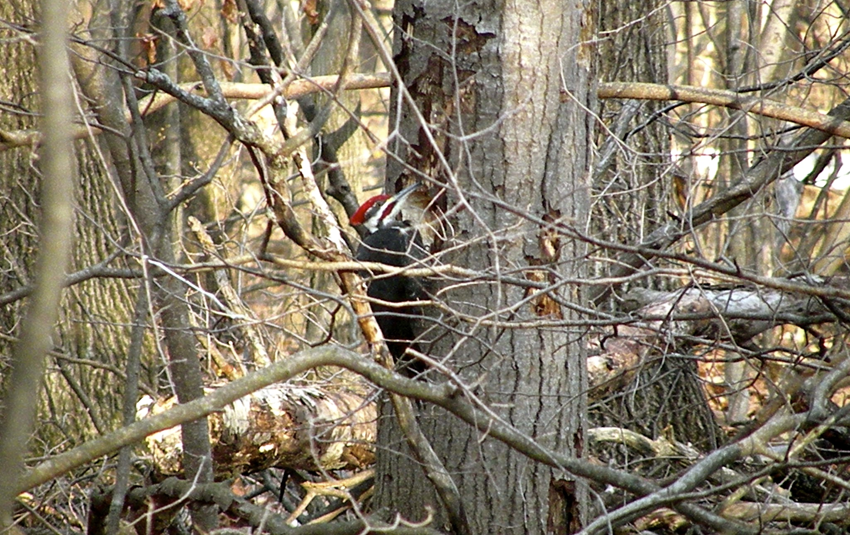
Pileated Woodpecker

Slide 4
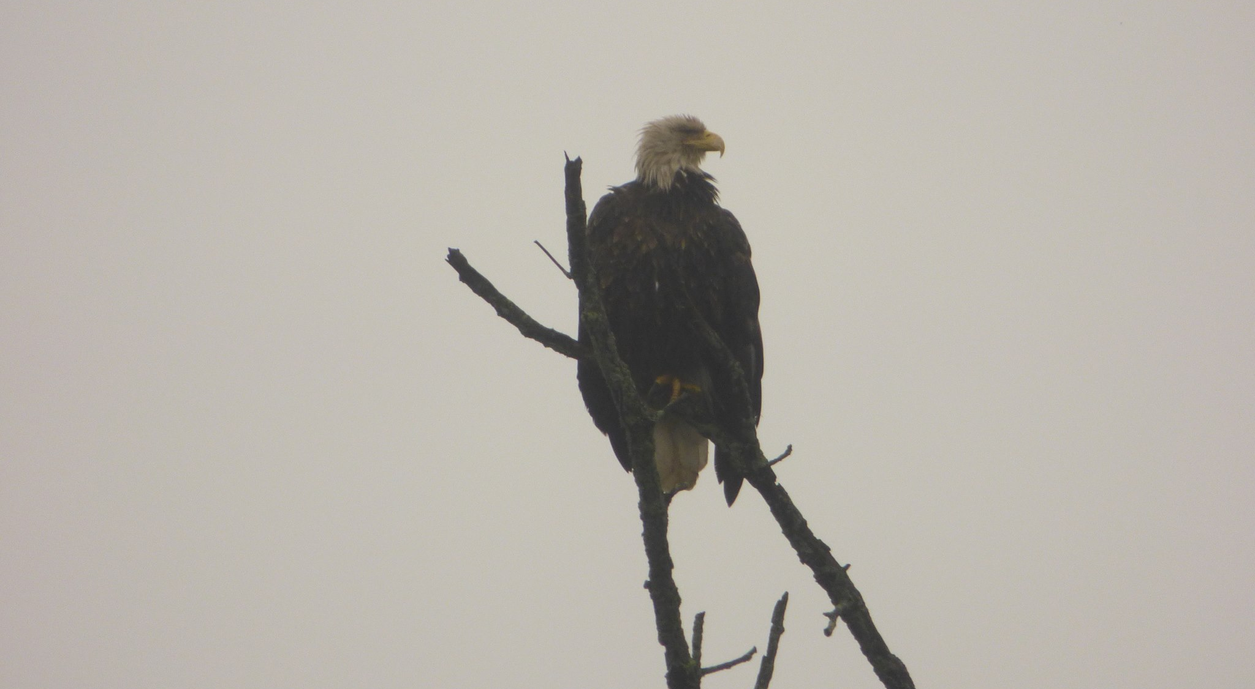
Bald Eagle

Slide 5
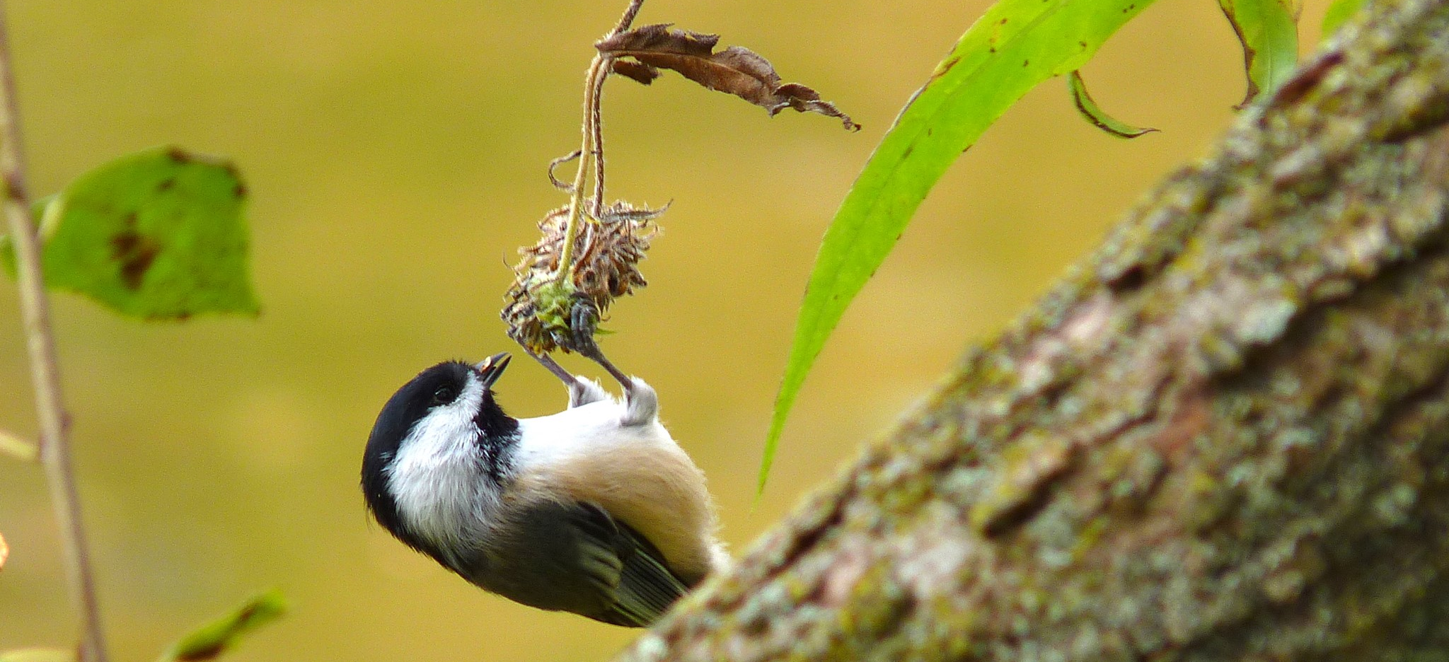
Black Capped Chickadee

